Slide 1

ECE 281 Lesson 15
Maj Walchko
1

Slide 2
Lesson 15 Outline
Do Time Logs!
Homework #2 (LSN 15/16 Worksheet) Due LSN 17
Lab #2 Prelab Due LSN 19
Finite State Machines – FSMs
Design FSMs

Slide 3
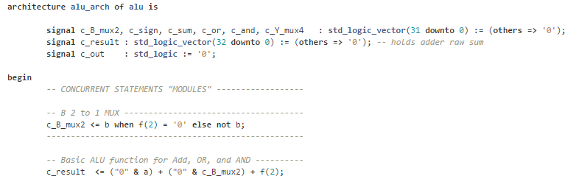
CE3
Define intermediate signals (wires)
c_B_mux2
c_result
Use comments to explain what is happening
Just a piece of the code … behavioral
Don’t forget to add 3 more test vectors of your own!!

Slide 4
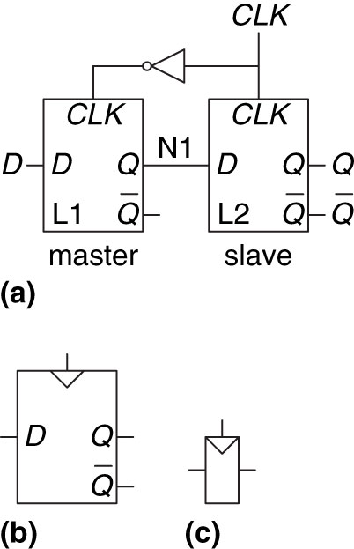
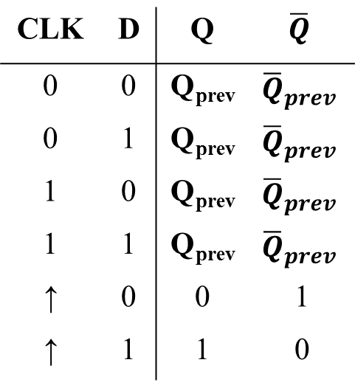
D-Flip Flop
CLK | D | Q | $$\overline{Q}$$
0 | 0 | Q_{prev} | $${\overline{Q}}_{prev}$$
0 | 1 | Q_{prev} | $${\overline{Q}}_{prev}$$
1 | 0 | Q_{prev} | $${\overline{Q}}_{prev}$$
1 | 1 | Q_{prev} | $${\overline{Q}}_{prev}$$
↑ | 0 | 0 | 1
↑ | 1 | 1 | 0
Figure 3.8 D flip-flop: (a) schematic, (b) symbol, (c) condensed symbol
Copyright © 2013 Elsevier Inc. All rights reserved.

Slide 5
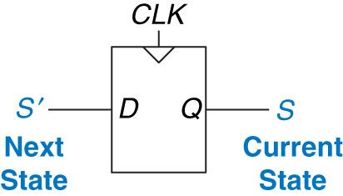
Flip-Flops
From last time: What do F/Fs create?
Memory!
When do F/Fs this?
Clock Edge!
Figure 3.20 Flip-flop current state and next state
Copyright © 2013 Elsevier Inc. All rights reserved.

Slide 6
Synchronous Circuit Properties
Synchronous circuit – Combinational circuit followed by bank of flip flops
Properties:
Each element is either a register or a combinational circuit
At least one circuit is a register
All registers have the same clock
Every cyclic path contains at least one register
Example: FSMs, Pipelines
Asynchronous circuit – Timing not limited by clock registers

Slide 7
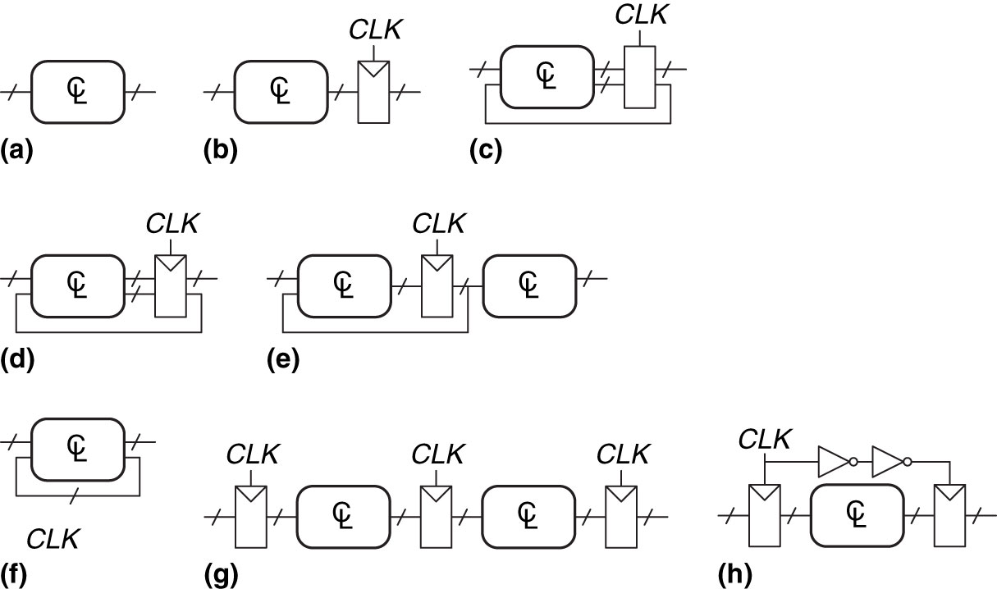
Examples of Circuits
Example 3.5: Synchronous Sequential Circuits
Each element is either a register or a combinational circuit
At least one circuit is a register
All registers have the same clock
Every cyclic path contains at least one register
Notes:
Solutions
Circuit:
(a) is combinational, not sequential, because it has no registers.
(b) is a simple sequential circuit with no feedback.
(c) is neither a combinational circuit nor a synchronous sequential circuit, because it has a latch that is neither a register nor a combinational circuit.
(d) and (e) are synchronous sequential logic; they are two forms of finite state machines, which are discussed in Section 3.4.
Same as (d)
(f) is neither combinational nor synchronous sequential, because it has a cyclic path from the output of the combinational logic back to the input of the same logic but no register in the path.
(g) is synchronous sequential logic in the form of a pipeline, which we will study in Section 3.6.
(h) is not, strictly speaking, a synchronous sequential circuit, because the second register receives a different clock signal than the first, delayed by two inverter delays.

Slide 8
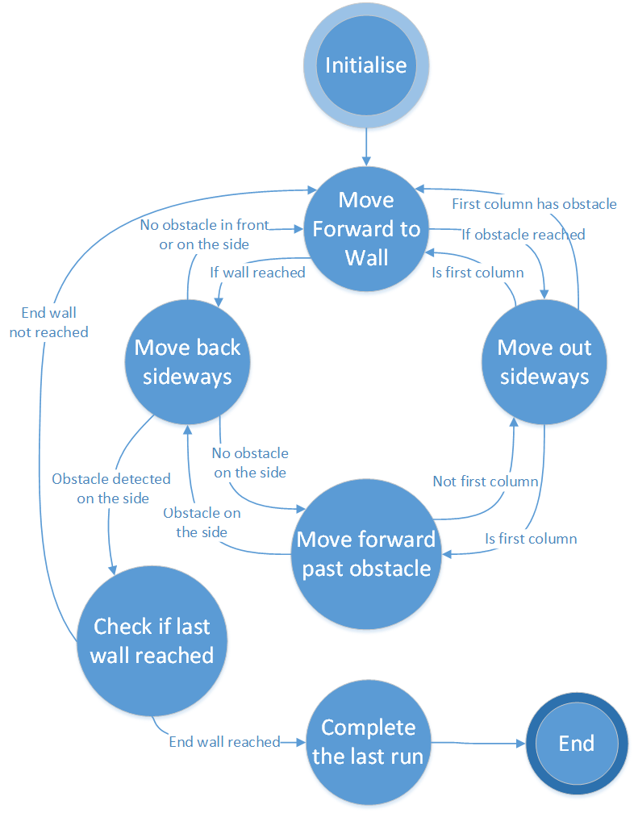
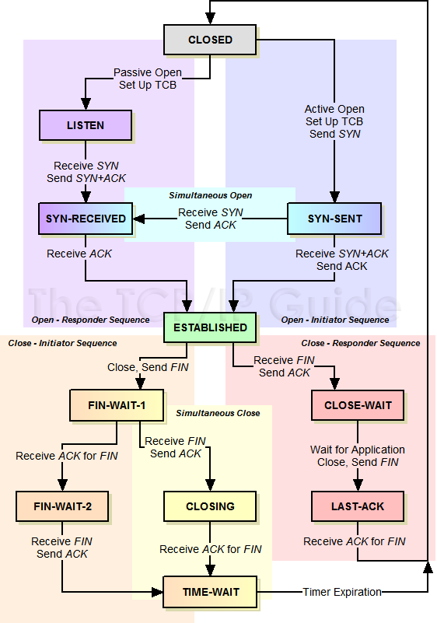
Finite State Machines
TCP
Robot

Slide 9
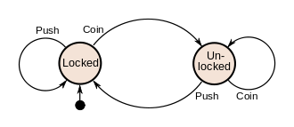
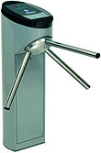
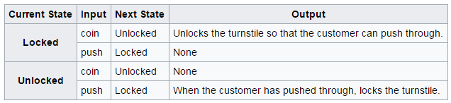
Simple Coin-operated Turnstile

Slide 10
Finite State Machines
FSM – M- inputs, N – Outputs, and K - bits of state
FSMs have K registers that can be one of a finite number (2^{K}) unique states
Two types of FSMs
Moore FSM
Mealy FSM
Clock
Next
State
Current
State
Inputs
M
Combinational Logic or
Next State Logic
K
Flip Flops
K
Output Logic
N
Outputs

Slide 11
Finite State Machines - Moore Machine
Moore Machine – outputs depend only on current state of the machine.
Clock
Next
State
Current
State
Inputs
M
Combinational Logic or
Next State Logic
K
Flip Flops
K
Output Logic
N
Outputs
C=1
In = 0
Random
Ex FSM
S0
Out=0
S1
Out=1
In =1
In = 0

Slide 12
Finite State Machines - Mealy Machine
Mealy Machine – outputs depend on both the current state and current inputs of the machine.
Clock
Next
State
Current
State
Inputs
M
Combinational Logic or
Next State Logic
K
Flip Flops
K
Output Logic
N
Outputs
In = 0
Out = 1
Random
Ex FSM
S0
S1
In =1
Out = 0
In = 0
Out = 1

Slide 13
Finite State Machines - Design
Real Life Examples of State Machines:
Soda Machine
Software Applications
Spell Checker – Using Soundex
Driving to School/Work
How to Design a State Machine:
0) Description
1) State Transition Diagram
2) State Transition Table & Output Table
3) Next State and Output State Equations
4) Schematic
Lets Build a Vending Machine:
Only takes Quarters. Only sells Root Beer (RB)
No change. 50₵ per Soda
Inputs: C = Coin (also, there’s a clock)
Outputs: S = Soda
Copyright © 2013 Elsevier Inc. All rights reserved.

Slide 14
Finite State Machines - Moore vs Mealy Machine
Moore Machine – outputs depend only on current state of the machine.
Mealy Machine – outputs depend on both the current state and current inputs of the machine.
Clock
Next
State
Current
State
Inputs
M
Combinational Logic or
Next State Logic
K
Flip Flops
K
Output Logic
N
Outputs
Clock
Next
State
Current
State
Inputs
M
Combinational Logic or
Next State Logic
K
Flip Flops
K
Output Logic
N
Outputs

Slide 15
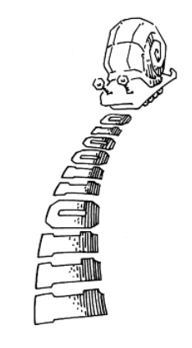
In-Class Exercise
Draw me a picture of a Mealy or Moore State Transition Diagram that shows
A Snail is crawling across a sequence of numbers and he smiles if the last 2 numbers are “11”
Sequence: 0100110111

Slide 16
In-Class Exercise – One Moore Solution
A Snail is crawling across a sequence of numbers and he smiles if the last 2 numbers are “11”
Sequence: 0100110111
N=0
N=1
reset
S0
☺=0
S1
☺=0
N=0
N=1
N=0
S3
☺=1
N=1

Slide 17

17

Slide 18
S0
$0
RB=0
C=1
S1
$0.25
RB=0
C=X
S2
$0.50
RB=1
C=1
C=0

Slide 19
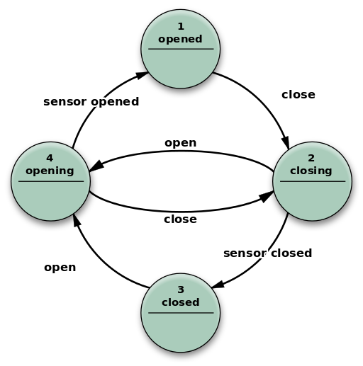
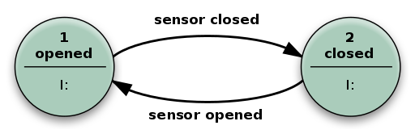
Mealy FSM
Moore FSM

Slide 20
Finite State Machines - Moore vs Mealy Machine
C=0
C=1
C=0
S0
0₵
T=0
S1
25₵
T=0
Red
R=1
G=0
Y=0
GreenR=0
G=1
Y=0
C=1
C=X
Yellow
R=0
G=0
Y=1
S2
T=0
Ghost State
S3
50₵
T=1

Slide 21
Homework – Review Book Example
Take a look at how the book implements “01”
Example 3.7 on p 132
A Snail is crawling across a sequence of numbers and he smiles if the last 2 numbers are “01”
Sequence: 0100110111

Slide 22
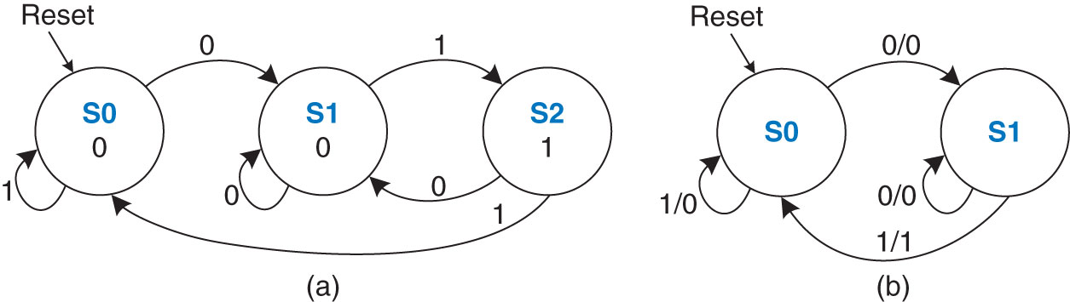
Homework – Review Book Example
Example 3.7 on p 132
A Snail is crawling across a sequence of numbers and he smiles if the last 2 numbers are “01”
Sequence: 0100110111
Figure 3.30 FSM state transition diagrams: (a) Moore machine, (b) Mealy machine
Copyright © 2013 Elsevier Inc. All rights reserved.

